Slide 1


REST endpoint tutorial
Mike Dolbow| GIS Supervisor
Notes:
Advertised description: Understanding and Using Esri REST Endpoints - Ever wonder what a “REST Endpoint” is? Or how “a Feature Service” works from ArcGIS Online (AGOL) or ArcGIS Server? Or how such services get integrated into web applications? Well, this presentation is for you. Mike Dolbow will demonstrate the concepts covered in this tutorial, including exploring the different parts of an Esri REST endpoint, building queries, and how services can be used in applications like ArcGIS Desktop or inside custom web applications.

Slide 2
Agenda
Topic
What is a REST endpoint
How to find endpoints
Explore with a Browser
Use in ArcMap
Use in other systems
Build Queries
Web Development: point in poly, GeoJSON
Q&A
Notes:
In this tutorial, Mike will explain what a REST endpoint is, using the endpoints created by Esri’s ArcGIS Server and ArcGIS Online to demonstrate. He will show you how to find REST endpoints on the Geospatial Commons (and elsewhere), how to explore them in a browser, and how to open the included layers in various systems. He will also show how they can be used to build queries, which can then be used by web developers for various purposes. He will show how these concepts are explained on a web tutorial and answer questions from attendees.

Slide 3
What is a REST endpoint?
Representational State Transfer, or REST, allows applications to consume services from a variety of "RESTful" services in order to sustain a distributed architecture.
A RESTful API is an application program interface (API) that uses HTTP requests to GET, PUT, POST and DELETE data.
This means you can use a browser to perform operations! Most commonly, GET – aka consume – aka show me a map, query some data, etc.
Esri-flavored (from ArcGIS Server, AGOL, etc) are not the only type of RESTful service – but they are today’s focus.

Slide 4
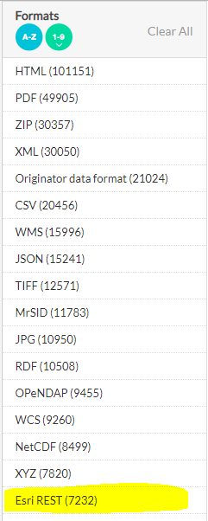
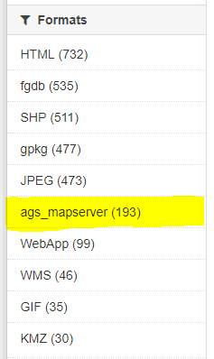
How do I find them?
In the Geospatial Commons
At Data.gov
From within AGOL
Esri’s Sample Servers
Esri’s Open Data Hub
By checking out the browser console (F12)

Slide 5

What is this “Browser Console” you speak of?
Let’s do a demo…

Slide 6
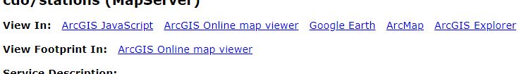
Explore with a Browser
Learn more about the service
Use in ArcGIS Desktop
Use in JSAPI
Use in AGOL
Back to the demo!

Slide 7
Types of Services
MapServer
FeatureServer
GPServer
Utilities

Slide 8
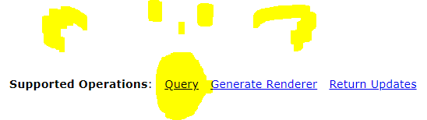
Build Queries
Pick a layer
Find “Query” operation at the bottom
Start trying stuff!
Demo (again)

Slide 9
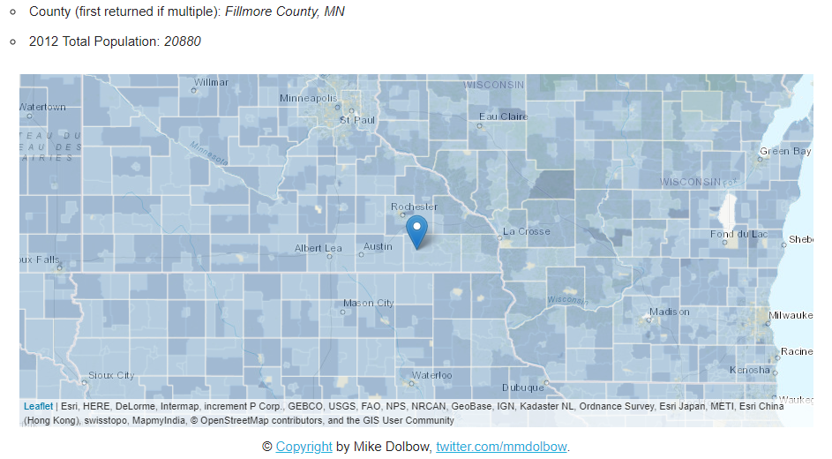
Web Development
Point in Poly
GeoJSON

Slide 10
Q&A
Learn More: http://mmdolbow.github.io/RESTendpts/index.html
Find code on Github: https://github.com/mmdolbow/RESTendpts
Find REST endpoints on the Commons: https://gisdata.mn.gov/dataset?res_format=ags_mapserver

Slide 11
Thank You!
Mike Dolbow
mike.dolbow@state.mn.us
651-201-3944

